Slide 1
Selection, Topic-Orientation & Information Ordering
Ling573
Systems & Applications
April 21, 2020

Slide 2
Roadmap
Content Selection:
Neural Graph Models
Optimization Methods

Slide 3
Graph-based Neural Multi-Document Summarization
Yasunaga et al, 2017
Challenges for NN-MDS:
Lack of large-scale training data for MDS
CNN/DailyNews sets are single document “highlights”
Difficult to model multi-document relations via RNN encoder-decoder methods

Slide 4
Graph-based Neural Multi-Document Summarization
Yasunaga et al, 2017
Challenges for NN-MDS:
Lack of large-scale training data for MDS
CNN/DailyNews sets are single document “highlights”
Difficult to model multi-document relations via RNN encoder-decoder methods
Strategy:
Salience estimation, sentence selection w/o decoder
Sentence relation graphs capture multi-doc relations

Slide 5
Sentence Salience Estimation
For each cluster of documents
Create sentence relation graph
Use GRU to create initial sentence embeddings (GRU^{sent)}
Apply Graph Convolutional Networks (GCN) to create final sentence embeddings informed by graph
Use GRU over all sents for cluster embedding (GRU^{doc)}
Use cluster & sentence embeddings for sentence salience

Slide 6
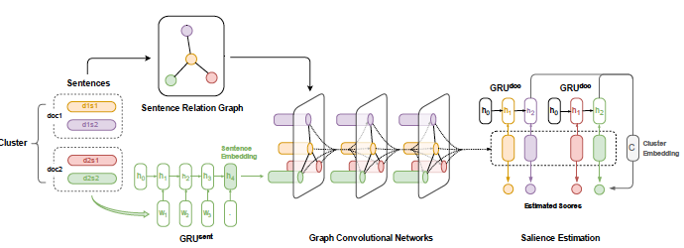
Architecture

Slide 7
Sentence Relation Graphs
LexRank style:
Edge if nodes have tf*idf > threshold (0.2)

Slide 8
Sentence Relation Graphs
LexRank style:
Edge if nodes have tf*idf > threshold (0.2)
ADG (Approximate Discourse Graph)(Christensen ea ’13)
Edges weighted by ct of discourse relation indicators
E.g. discourse markers, co-referent mentions, etc
N.B. edge weights discrete (0.5), and often 1

Slide 9
Sentence Relation Graphs
LexRank style:
Edge if nodes have tf*idf > threshold (0.2)
ADG (Approximate Discourse Graph)(Christensen ea ’13)
Edges weighted by ct of discourse relation indicators
E.g. discourse markers, co-referent mentions, etc
N.B. edge weights discrete (0.5), and often 1
PDG (Personalized Discourse Graph)
Computes sentence score via regression
Used as multiplier on ADG weights

Slide 10
PDG factors
Relate to discourse coherence and doc salience
Position in document
In 1st 3 sentences?
# Proper nouns
> 20 tokens in sentence?
Sentence length
# Coreferent verbal mentions
# Coreferent common noun mentions
# Coreferent proper noun mentions

Slide 11
Next Steps
Graph Convolution Network (GCN) (Kipf, Welling ‘17)
Z = f(X,A)=H^{(L)}
where X = sentence node embeddings
Final hidden state of sentence GRU
A = adjacency matrix of nodes, edges, weights
Output is high-level hidden features for each node, s_{i}

Slide 12
Next Steps
Graph Convolution Network (GCN) (Kipf, Welling ‘17)
Z = f(X,A)=H^{(L)}
where X = sentence node embeddings
Final hidden state of sentence GRU
A = adjacency matrix of nodes, edges, weights
Output is high-level hidden features for each node, s_{i}
Cluster embedding: C
Average over document embeddings
Final hidden state of sentence sequence GRU

Slide 13
Next Steps
Graph Convolution Network (GCN) (Kipf, Welling ‘17)
Z = f(X,A)=H^{(L)}
where X = sentence node embeddings
Final hidden state of sentence GRU
A = adjacency matrix of nodes, edges, weights
Output is high-level hidden features for each node, s_{i}
Cluster embedding: C
Average over document embeddings
Final hidden state of sentence sequence GRU
Salience score computed from cluster & graph sents
f(s_{i})=v^{T}(W₁C+W₂s_{i})

Slide 14
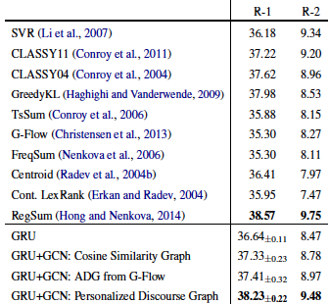
Results

Slide 15
Optimization Approaches to Reducing Redundancy
DPP: Determinantal Point Processes (Kulesza &Taskar, ‘12)
Set models balancing information importance w/diversity
ICSISumm: Uses Integer Linear Programming frame
Optimizes coverage of key bigrams weighted by doc freq
OCCAMS_V
Uses LSA (Latent Semantic Analysis) to weight terms
Sentence selection via optimization problems:
Budgeted maximal coverage; knapsack

Slide 16
ICSISumm
Key ideas:
Cast summarization as optimization problem
Identify important “concepts” to incorporate
Build best such summary
Implemented as integer linear programming

Slide 17
Integer Linear Programming
Aka ILP
An integer linear program specifies:
A single linear maximization term
Subject to linear equality/inequality constraints
Involving integer valued variables

Slide 18
Summarization as ILP
Map summary requirements to ILP elements

Slide 19
Summarization as ILP
Map summary requirements to ILP elements
Summary goal:

Slide 20
Summarization as ILP
Map summary requirements to ILP elements
Summary goal:
“best” summary
Summary requirements:

Slide 21
Summarization as ILP
Map summary requirements to ILP elements
Summary goal:
“best” summary
Summary requirements:
Minimize redundancy
Within desired length

Slide 22
Summarization as ILP
Summary goal:
“best” summary
Summary requirements:
Minimize redundancy
Within desired length
Maximization term:

Slide 23
Summarization as ILP
Summary goal:
“best” summary
Summary requirements:
Minimize redundancy
Within desired length
Maximization term:

Slide 24
Summarization as ILP
Summary goal:
“best” summary
Summary requirements:
Minimize redundancy
Within desired length
Maximization term:
Implicit:
Length constraint:

Slide 25
Summarization as ILP
Summary goal:
“best” summary
Summary requirements:
Minimize redundancy
Within desired length
Maximization term:
Implicit:
Length constraint:
Coverage constraint:

Slide 26
Summarization as ILP
Summary goal:
“best” summary
Summary requirements:
Minimize redundancy
Within desired length
Maximization term:
Implicit:
Length constraint:
Coverage constraint:
Concept covered by sent

Slide 27
Representing Concepts
Concepts =

Slide 28
Representing Concepts
Concepts = Bigrams
Stemmed
No stopword-only bigrams
Occurring in at least 3 documents
Weights:

Slide 29
Representing Concepts
Concepts = Bigrams
Stemmed
No stopword-only bigrams
Occurring in at least 3 documents
Weights:
Document frequency:
# of documents (from cluster) for bigram

Slide 30
Representing Concepts
Concepts = Bigrams
Stemmed
No stopword-only bigrams
Occurring in at least 3 documents
Weights:
Document frequency:
# of documents (from cluster) for bigram
Selected sentences must contain >= 2 query terms

Slide 31
Results
After using open source solver
2009 results:
2nd best pyramid, ROUGE-2
Best ROUGE-3, ROUGE-4
(Interesting sentence compression: later…)

Slide 32
Roadmap
Topic-focused summarization
LexRank
Joint neural focusing and selection
CLASSY, FastSum
Overview

Slide 33
Key Idea
Topic-focused summarization
(aka ”query-focused”, “guided”)

Slide 34
Key Idea
Topic-focused summarization
(aka ”query-focused”, “guided”)
Motivations:
Extrinsic task vs generic
Why are we creating this summary?
Viewed as complex question answering (vs factoid)

Slide 35
Key Idea
Topic-focused summarization
(aka ”query-focused”, “guided”)
Motivations:
Extrinsic task vs generic
Why are we creating this summary?
Viewed as complex question answering (vs factoid)
High variation in human summaries
Depending on perspective different content focused

Slide 36
Key Idea
Topic-focused summarization
(aka ”query-focused”, “guided”)
Motivations:
Extrinsic task vs generic
Why are we creating this summary?
Viewed as complex question answering (vs factoid)
High variation in human summaries
Depending on perspective, different content focused
Idea:
Target response to specific question, topic in docs

Slide 37
Key Idea
Topic-focused summarization
(aka ”query-focused”, “guided”)
Motivations:
Extrinsic task vs generic
Why are we creating this summary?
Viewed as complex question answering (vs factoid)
High variation in human summaries
Depending on perspective different content focused
Idea:
Target response to specific question, topic in docs
Later TACs identify topic categories and aspects
E.g Natural disasters: who, what, where, when..

Slide 38
Query-focused LexRank
Focus on sentences relevant to query
Rather than uniform jump

Slide 39
Query-focused LexRank
Focus on sentences relevant to query
Rather than uniform jump
How do we measure relevance?

Slide 40
Query-focused LexRank
Focus on sentences relevant to query
Rather than uniform jump
How do we measure relevance?
Tf*idf-like measure over sentences & query

Slide 41
Query-focused LexRank
Focus on sentences relevant to query
Rather than uniform jump
How do we measure relevance?
Tf*idf-like measure over sentences & query
Compute sentence-level “idf”
N = # of sentences in cluster; sf_{w} = # of sentences with w

Slide 42
Query-focused LexRank
Focus on sentences relevant to query
Rather than uniform jump
How do we measure relevance?
Tf*idf-like measure over sentences & query
Compute sentence-level “idf”
N = # of sentences in cluster; sf_{w} = # of sentences with w

Slide 43
Updated LexRank Model
Combines original similarity weighting w/query

Slide 44
Updated LexRank Model
Combines original similarity weighting w/query
Mixture model of query relevance, sentence similarity

Slide 45
Updated LexRank Model
Combines original similarity weighting w/query
Mixture model of query relevance, sentence similarity
d controls ‘bias’: i.e. relative weighting

Slide 46
Tuning & Assessment
Parameters:
Similarity threshold: filters adjacency matrix
Question bias: Weights emphasis on question focus

Slide 47
Tuning & Assessment
Parameters:
Similarity threshold: filters adjacency matrix
Question bias: Weights emphasis on question focus
Parameter sweep:
Best similarity threshold: 0.14-0.2
As before
Best question bias: high: 0.8-0.95

Slide 48
Tuning & Assessment
Parameters:
Similarity threshold: filters adjacency matrix
Question bias: Weights emphasis on question focus
Parameter sweep:
Best similarity threshold: 0.14-0.2
As before
Best question bias: high: 0.8-0.95
Question bias in LexRank can improve

Slide 49
AttSum
Cao et al, 2016
Key ideas:
Integration of query focus & sentence salience
Distributed representations of sentences, docs
Augmented with attention model

Slide 50
Intuitions
Human summaries jointly optimize focus, salience
Difficult to train independently
Models often focus on surface models of similarity
E.g. tf*idf on words/signature terms
Similarity != relevance
Proposal: Joint neural model
Reduce dependence on surface similarity
Combine two factors

Slide 51
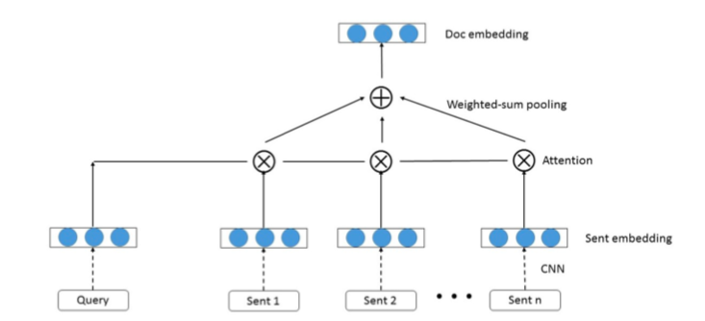
Architecture

Slide 52
Sentence & Query Representations
Both sentence & query representations
Created using convolutional NN (CNN)
Start with sequence of word embeddings
Apply filter W^{h}_{t} over concatenation of wds in window
Followed by tanh non-linearity
Finally apply max-pooling-over-time to create rep c^{h}

Slide 53
Creating “Document” Representation
Weighted-sum pooling over sentences
“Document” = all sentences in all documents in cluster
Learn a score that serves as relevance weighting b/t sentence and query
r(s,q) = σ(v(s)Mv(q)^{T})
Should be high if relevant
Compute document representation as weighted sum
v(d|q) = Σ_{s in d}r(s,q)v(s)

Slide 54
Ranking Sentences
Sentences ranked by similarity to doc cluster
Via cosine similarity
v(s)•v(d|q)/||v(s)||•||v(d|q)||
Trained via pairwise ranking
High ROUGE-2(s) → pos, Low ROUGE-2(s) → neg
Learn to give higher cos score to pos than neg

Slide 55
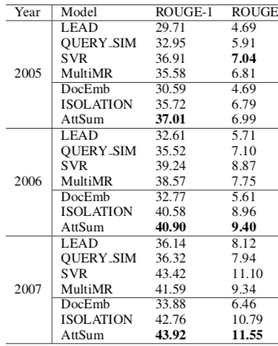
Overall Effectiveness

Slide 56
Summary Generation
Discard sentences < 8 wds long
Rank all others by score
Iteratively, until max length:
Select highest sentence
Discard if redundant
> 50% bigram overlap
Add to summary

Slide 57
Other Strategies
Methods depend on base system design
All aim to incorporate similarity with query/topic

Slide 58
Other Strategies
Methods depend on base system design
All aim to incorporate similarity with query/topic
CLASSY HMM:

Slide 59
Other Strategies
Methods depend on base system design
All aim to incorporate similarity with query/topic
CLASSY HMM:
Add question overlap feature to HMM vector

Slide 60
Other Strategies
Methods depend on base system design
All aim to incorporate similarity with query/topic
CLASSY HMM:
Add question overlap feature to HMM vector
Log (# query tokens in sentence + 1)
Query tokens: tagged as noun, verb, adj, adv, or proper nouns

Slide 61
Other Strategies
Methods depend on base system design
All aim to incorporate similarity with query/topic
CLASSY HMM:
Add question overlap feature to HMM vector
Log (# query tokens in sentence + 1)
Query tokens: tagged as noun, verb, adj, adv, or proper nouns
Other, more aggressive approach detrimental
FastSum: SVM regression on sentences

Slide 62
Other Strategies
Methods depend on base system design
All aim to incorporate similarity with query/topic
CLASSY HMM:
Add question overlap feature to HMM vector
Log (# query tokens in sentence + 1)
Query tokens: tagged as noun, verb, adj, adv, or proper nouns
Other, more aggressive approach detrimental
FastSum: SVM regression on sentences
Adds topic title & description frequency features:
Proportion of words in sent which appear in title/descr

Slide 63
Other Strategies
Methods depend on base system design
All aim to incorporate similarity with query/topic
CLASSY HMM:
Add question overlap feature to HMM vector
Log (# query tokens in sentence + 1)
Query tokens: tagged as noun, verb, adj, adv, or proper nouns
Other, more aggressive approach detrimental
FastSum: SVM regression on sentences
Adds topic title & description frequency features:
Proportion of words in sent which appear in title/desc
Others: Require minimum number of topic words

Slide 64
Overview
Many similar strategies:
Features, weighting, ranking: overlap based

Slide 65
Overview
Many similar strategies:
Features, weighting, ranking: overlap based
Actual evaluation impact:
Not necessarily very large (e.g. 0.003 ROUGE)
But can be useful

Slide 66
Overview
Many similar strategies:
Features, weighting, ranking: overlap based
Actual evaluation impact:
Not necessarily very large (e.g. 0.003 ROUGE)
But can be useful
Aggressive approaches can have large negative impact
I.e. explicitly adding NER spans

Slide 67
Information Ordering

Slide 68
Basics
Content selection:
Identified sentences or information units for summary

Slide 69
Basics
Content selection:
Identified sentences or information units for summary
Information ordering:
Linearize selected content into a smooth-flowing text

Slide 70
Basics
Content selection:
Identified sentences or information units for summary
Information ordering:
Linearize selected content into a smooth-flowing text
Factors:
Semantics

Slide 71
Basics
Content selection:
Identified sentences or information units for summary
Information ordering:
Linearize selected content into a smooth-flowing text
Factors:
Semantics
Chronology: respect sequential flow of content (esp. events)
Discourse

Slide 72
Basics
Content selection:
Identified sentences or information units for summary
Information ordering:
Linearize selected content into a smooth-flowing text
Factors:
Semantics
Chronology: respect sequential flow of content (esp. events)
Discourse
Cohesion: Adjacent sentences talk about same thing
Coherence: Adjacent sentences naturally related (PDTB)

Slide 73
Single vs Multi-Document
Strategy for single-document summarization?

Slide 74
Single vs Multi-Document
Strategy for single-document summarization?
Just keep original order
Chronology? Cohesion? Coherence?
Multi-document

Slide 75
Single vs Multi-Document
Strategy for single-document summarization?
Just keep original order
Chronology? Cohesion? Coherence?
Multi-document
“Original order” can be problematic
Chronology?

Slide 76
Single vs Multi-Document
Strategy for single-document summarization?
Just keep original order
Chronology? Cohesion? Coherence?
Multi-document
“Original order” can be problematic
Chronology?
Publication order vs document-internal order
Differences in document ordering of information

Slide 77
Single vs Multi-Document
Strategy for single-document summarization?
Just keep original order
Chronology? Cohesion? Coherence?
Multi-document
“Original order” can be problematic
Chronology?
Publication order vs document-internal order
Differences in document ordering of information
Cohesion?
Coherence?

Slide 78
Single vs Multi-Document
Strategy for single-document summarization?
Just keep original order
Chronology? Ok Cohesion? Ok Coherence? Iffy
Multi-document
“Original order” can be problematic
Chronology?
Publication order vs document-internal order
Differences in document ordering of information
Cohesion? Probably poor
Coherence? Probably poor

Slide 79
Example
Hemingway, 69, died of natural causes in a Miami jail after being arrested for indecent exposure.
A book he wrote about his father, “Papa: A Personal Memoir”, was published in 1976.
He was picked up last Wednesday after walking naked in Miami.
“He had a difficult life.”
A transvestite who later had a sex-change operation, he suffered bouts of drinking, depression and drifting according to acquaintances.
“It’s not easy to be the son of a great man,” Scott Donaldson, told Reuters.

Slide 80
A Bad Example
Hemingway, 69, died of natural causes in a Miami jail after being arrested for indecent exposure.
A book he wrote about his father, “Papa: A Personal Memoir”, was published in 1976.
He was picked up last Wednesday after walking naked in Miami.
“He had a difficult life.”
A transvestite who later had a sex-change operation, he suffered bouts of drinking, depression and drifting according to acquaintances.
“It’s not easy to be the son of a great man,” Scott Donaldson, told Reuters.

Slide 81
A Basic Approach
Publication chronology:
Given a set of ranked extracted sentences
Order by:

Slide 82
A Basic Approach
Publication chronology:
Given a set of ranked extracted sentences
Order by:
Across articles

Slide 83
A Basic Approach
Publication chronology:
Given a set of ranked extracted sentences
Order by:
Across articles
By publication date
Within articles

Slide 84
A Basic Approach
Publication chronology:
Given a set of ranked extracted sentences
Order by:
Across articles
By publication date
Within articles
By original sentence ordering
Clearly not ideal, but used in some eval. submissions

Slide 85
Improving Ordering
Improve some set of chronology, cohesion, coherence
Chronology, cohesion (Barzilay et al, ‘02)
Key ideas:
Summarization and chronology over “themes”
Identifying cohesive blocks within articles
Combining constraints for cohesion within time structure

Slide 86
Importance of Ordering
Analyzed DUC summaries scoring poor on ordering
Manually reordered existing sentences to improve

Slide 87
Importance of Ordering
Analyzed DUC summaries scoring poor on ordering
Manually reordered existing sentences to improve
Human judges scored both sets:
Incomprehensible, Somewhat Comprehensible, Comp.
Manually reorderings judged:

Slide 88
Importance of Ordering
Analyzed DUC summaries scoring poor on ordering
Manually reordered existing sentences to improve
Human judges scored both sets:
Incomprehensible, Somewhat Comprehensible, Comp.
Manually reorderings judged:
As good or better than originals
Argues that people are sensitive to ordering, ordering can improve assessment

Slide 89
Framework
Build on their existing systems (Multigen)
Motivated by issues of similarity and difference
Managing redundancy and contradiction in docs

Slide 90
Framework
Build on their existing systems (Multigen)
Motivated by issues of similarity and difference
Managing redundancy and contradiction in docs
Analysis groups sentences into “themes”
Text units from diff’t docs with repeated information
Roughly clusters of sentences with similar content
Intersection of their information is summarized

Slide 91
Framework
Build on their existing systems (Multigen)
Motivated by issues of similarity and difference
Managing redundancy and contradiction in docs
Analysis groups sentences into “themes”
Text units from diff’t docs with repeated information
Roughly clusters of sentences with similar content
Intersection of their information is summarized
Ordering is done on this selected content

Slide 92
Chronological Orderings I
Two basic strategies explored:
CO:
Need to assign dates to themes for ordering

Slide 93
Chronological Orderings I
Two basic strategies explored:
CO:
Need to assign dates to themes for ordering
Theme sentences from multiple docs, lots of dup content
Temporal relation extraction

Slide 94
Chronological Orderings I
Two basic strategies explored:
CO:
Need to assign dates to themes for ordering
Theme sentences from multiple docs, lots of dup content
Temporal relation extraction is hard, try simple sub.
Doc publication date: what about duplicates?

Slide 95
Chronological Orderings I
Two basic strategies explored:
CO:
Need to assign dates to themes for ordering
Theme sentences from multiple docs, lots of dup content
Temporal relation extraction is hard, try simple sub.
Doc publication date: what about duplicates?
Theme date: earlier pub date for theme sentence
Order themes by date
If different themes have same date?

Slide 96
Chronological Orderings I
Two basic strategies explored:
CO:
Need to assign dates to themes for ordering
Theme sentences from multiple docs, lots of dup content
Temporal relation extraction is hard, try simple sub.
Doc publication date: what about duplicates?
Theme date: earlier pub date for theme sentence
Order themes by date
If different themes have same date?
Same article, so use article order
Slightly more sophisticated than simplest model

Slide 97
Chronological Orderings II
MO (Majority Ordering):
Alternative approach to ordering themes
Order the whole themes relative to each other
i.e. Th1 precedes Th2
How?

Slide 98
Chronological Orderings II
MO (Majority Ordering):
Alternative approach to ordering themes
Order the whole themes relative to each other
i.e. Th1 precedes Th2
How? If all sentences in Th1 before all sentences in Th2?

Slide 99
Chronological Orderings II
MO (Majority Ordering):
Alternative approach to ordering themes
Order the whole themes relative to each other
i.e. Th1 precedes Th2
How? If all sentences in Th1 before all sentences in Th2?
Easy: Th1 b/f Th2
If not?

Slide 100
Chronological Orderings II
MO (Majority Ordering):
Alternative approach to ordering themes
Order the whole themes relative to each other
i.e. Th1 precedes Th2
How? If all sentences in Th1 before all sentences in Th2?
Easy: Th1 b/f Th2
If not? Majority rule
Problematic b/c not guaranteed transitive
Create an ordering by modified topological sort over graph

Slide 101
Chronological Orderings II
MO (Majority Ordering):
Alternative approach to ordering themes
Order the whole themes relative to each other
i.e. Th1 precedes Th2
How? If all sentences in Th1 before all sentences in Th2?
Easy: Th1 b/f Th2
If not? Majority rule
Problematic b/c not guaranteed transitive
Create an ordering by modified topological sort over graph
Nodes are themes:
Weight: sum of outgoing edges minus sum of incoming edges
Edges E(x,y): precedence, weighted by # texts
where sentences in x precede those in y

Slide 102
CO vs MO
 | Poor | Fair | Good
MO | 3 | 14 | 8
CO | 10 | 8 | 7

Slide 103
CO vs MO
Neither of these is particularly good:
MO works when presentation order consistent
When inconsistent, produces own brand new order
 | Poor | Fair | Good
MO | 3 | 14 | 8
CO | 10 | 8 | 7

Slide 104
CO vs MO
Neither of these is particularly good:
MO works when presentation order consistent
When inconsistent, produces own brand new order
CO problematic on:
Themes that aren’t tied to document order
E.g. quotes about reactions to events
Multiple topics not constrained by chronology
 | Poor | Fair | Good
MO | 3 | 14 | 8
CO | 10 | 8 | 7

Slide 105
New Approach
Experiments on sentence ordering by subjects
Many possible orderings but far from random
Blocks of sentences group together (cohere)

Slide 106
New Approach
Experiments on sentence ordering by subjects
Many possible orderings but far from random
Blocks of sentences group together (cohere)
Combine chronology with cohesion
Order chronologically, but group similar themes

Slide 107
New Approach
Experiments on sentence ordering by subjects
Many possible orderings but far from random
Blocks of sentences group together (cohere)
Combine chronology with cohesion
Order chronologically, but group similar themes
Perform topic segmentation on original texts
Themes “related” if,

Slide 108
New Approach
Experiments on sentence ordering by subjects
Many possible orderings but far from random
Blocks of sentences group together (cohere)
Combine chronology with cohesion
Order chronologically, but group similar themes
Perform topic segmentation on original texts
Themes “related” if, when two themes appear in same text, they frequently appear in same segment (threshold)

Slide 109
New Approach
Experiments on sentence ordering by subjects
Many possible orderings but far from random
Blocks of sentences group together (cohere)
Combine chronology with cohesion
Order chronologically, but group similar themes
Perform topic segmentation on original texts
Themes “related” if, when two themes appear in same text, they frequently appear in same segment (threshold)
Order over groups of themes by CO,
Then order within groups by CO
Significantly better!

Slide 110
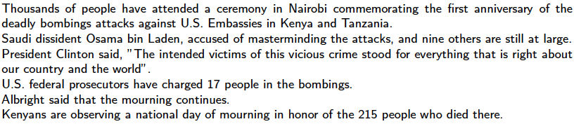
Before and After

Slide 111
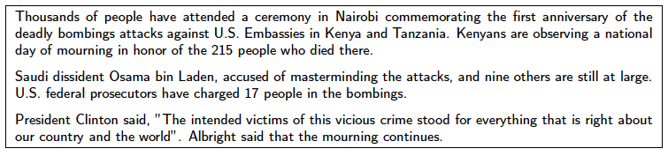
Before and After

Slide 112
Deliverable #3
Goals:
Focus on information ordering
Using one or more of:
Chronology, Cohesion, Coherence
Continue to improve content selection
Incorporate some guided/topic-orientation
Same deliverable structure as D#2
Due in 3 weeks:
Code/results; Updated report

Slide 113
Notes
Deliverable 2:
Code/results
Updated project report
Presentations next week:
Doodle poll will be sent after class
Please email me slide deck (or pointer) by noon
Quick audio check - please

